Slide 1
Message queue in OpenStack
Build services based on queues

Slide 2
Agenda
Messaging queue introduction
AMQP and RabbitMQ
Oslo messaging
Apache kafka

Slide 3
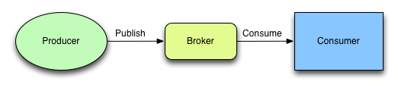
What is message queue
A message queue is a way for applications and discrete components to send messages between one another in order to reliably communicate.

Slide 4
Why use message queue
Decoupling
Scalability
Delivery Guarantees
Buffering
Asynchronous Communication

Slide 5
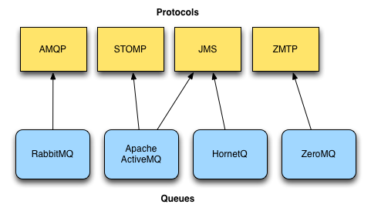
Popular message queue protocols

Slide 6
About AMQP
The Advanced Message Queuing Protocol (AMQP) is an open standard application layer protocol for message-oriented middleware
AMQP was originated in 2003 by John O‘Hara at JPMorgan Chase in London, UK
0.9.1 finalized in November 2008
1.0 Final: October 2011
AMQP working group, Bank of America, Barclays, Cisco Systems, IIT Software, JPMorgan Chase, Microsoft, Novell, Red Hat, Vmware.

Slide 7

About RabbitMQ
A open source message broker software written in Erlang
Born in 2006, release in 2007, acquired in 2010
Features include:
Persistent
Delivery acknowledgements
Flexible routing
Multiple protocols, AMQP 1.0, 0-9-1, 0-9, 0-8, STOMP, MQTT and HTTP
Plugins
Clustering
Notes:
mark both the queue and messages as durable
Message acknowledgments are turned on by default, what if client forget to send back ack

Slide 8
Queues
Store messages that are consumed by applications
Durable, survives reboot
Exclusive, used by only one connection and the queue will be deleted when that connection closes
Auto-delete, queue is deleted when last consumer unsubscribes
To receive messages, a queue must be binded to a exchange

Slide 9
Exchanges
take a message and route it into zero or more queues
Direct
Topic
Fanout
Durable
Auto-delete

Slide 10
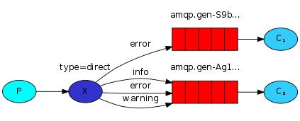
Direct
A queue binds to the exchange with a routing key K
When a new message with routing key R arrives at the direct exchange, the exchange routes it to the queue if K = R

Slide 11
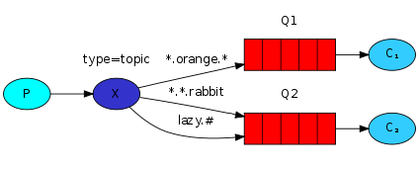
Topic
Pattern matching in routing key
* (star) can substitute for exactly one word
# (hash) can substitute for zero or more words
slower than direct and fanout

Slide 12
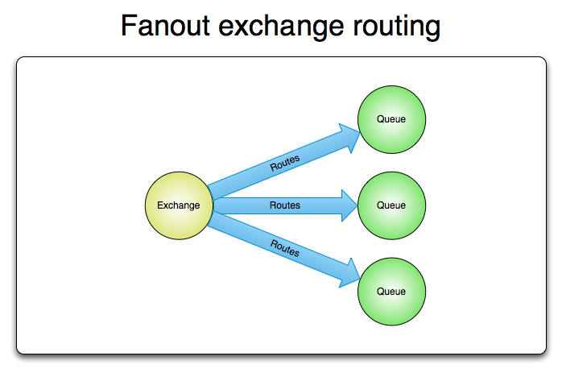
Fanout
Routes messages to all of the queues that are bound to it and the routing key is ignored
Fanout exchanges are ideal for the broadcast routing of messages

Slide 13
Oslo Messaging
The Oslo messaging library provides two independent APIs, build on top of messaging queue.
oslo.messaging.rpc for implementing client-server remote procedure calls
oslo.messaging.notify for emitting and handling event notifications
Multiple transports supported
RabbitMQ(AMQP)
Qpid(AMQP)
ZeroMQ

Slide 14
RPC
What is RPC
Remote Procedure Call (RPC) is a protocol that one program can use to request a service from a program located in another computer in a network without having to understand network details. (A procedure call is also sometimes known as a function call or a subroutine call.)
XML RPC, JSON RPC, SOAP
Always act as client/server

Slide 15
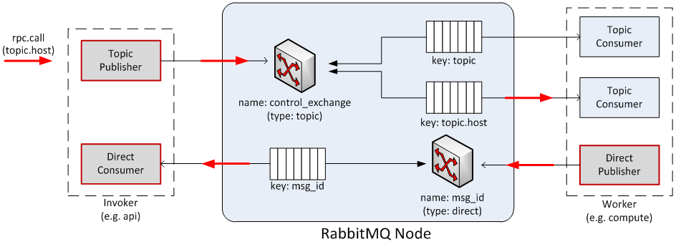
RPC

Slide 16
RPC
oslo_messaging.get_transport(conf, url=None, allowed_remote_exmods=None, aliases=None)
oslo_messaging.Target(exchange=None, topic=None, namespace=None, version=None, server=None, fanout=None, legacy_namespaces=None)
oslo_messaging.get_rpc_server(transport, target, endpoints, executor='blocking', serializer=None
oslo_messaging.RPCClient(transport, target, timeout=None, version_cap=None, serializer=None, retry=None)
Notes:
Target, identifies the destination of messages. A Target encapsulates all the information to identify where a message should be sent or what messages a server is listening for.

Slide 17
RPC Example

Slide 18
Notify
oslo_messaging.Notifier(transport, publisher_id=None, driver=None, topic=None, serializer=None, retry=None)
oslo_messaging.get_notification_listener(transport, targets, endpoints, executor='blocking', serializer=None, allow_requeue=False, pool=None)

Slide 19
Notify

Slide 20
Use cases
Used in many OpenStack project, Nova, Cinder, Neutron, Ceilometer and so on.
https://wiki.openstack.org/wiki/Oslo/Messaging#Use_Cases

Slide 21

Kafka, Next Generation Distributed Messaging System

Slide 22
Kafka, Next Generation Distributed Messaging System
Apache Kafka was originally developed by LinkedIn, and was subsequently open sourced in early 2011. Graduation from the Apache Incubator occurred on 23 October 2012. In November 2014, the engineers that built Kafka at LinkedIn created a new company named Confluent around the project.
A real-time, fault tolerant, highly scalable messaging system written in Scala.

Slide 23
Companies who use Kafka
LinkedIn - Apache Kafka is used at LinkedIn for activity stream data and operational metrics. This powers various products like LinkedIn Newsfeed, LinkedIn Today in addition to our offline analytics systems like Hadoop.
Yahoo - kafka is used by many teams across Yahoo. The Media Analytics team uses Kafka in our real-time analytics pipeline. Our Kafka cluster handles a peak bandwidth of more than 20Gbps (of compressed data).
Twitter - As part of their Storm stream processing infrastructure.
Netflix - Real-time monitoring and event-processing pipeline.
Airbnb - Used in our event pipeline, exception tracking & more to come.
Coursera - At Coursera, Kafka powers education at scale, serving as the data pipeline for realtime learning analytics/dashboards

Slide 24
Use cases
Messaging
Website Activity Tracking
Metrics
Log Aggregation
Stream Processing
Event Sourcing
Commit Log

Slide 25
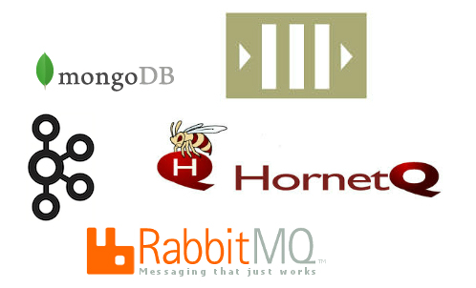
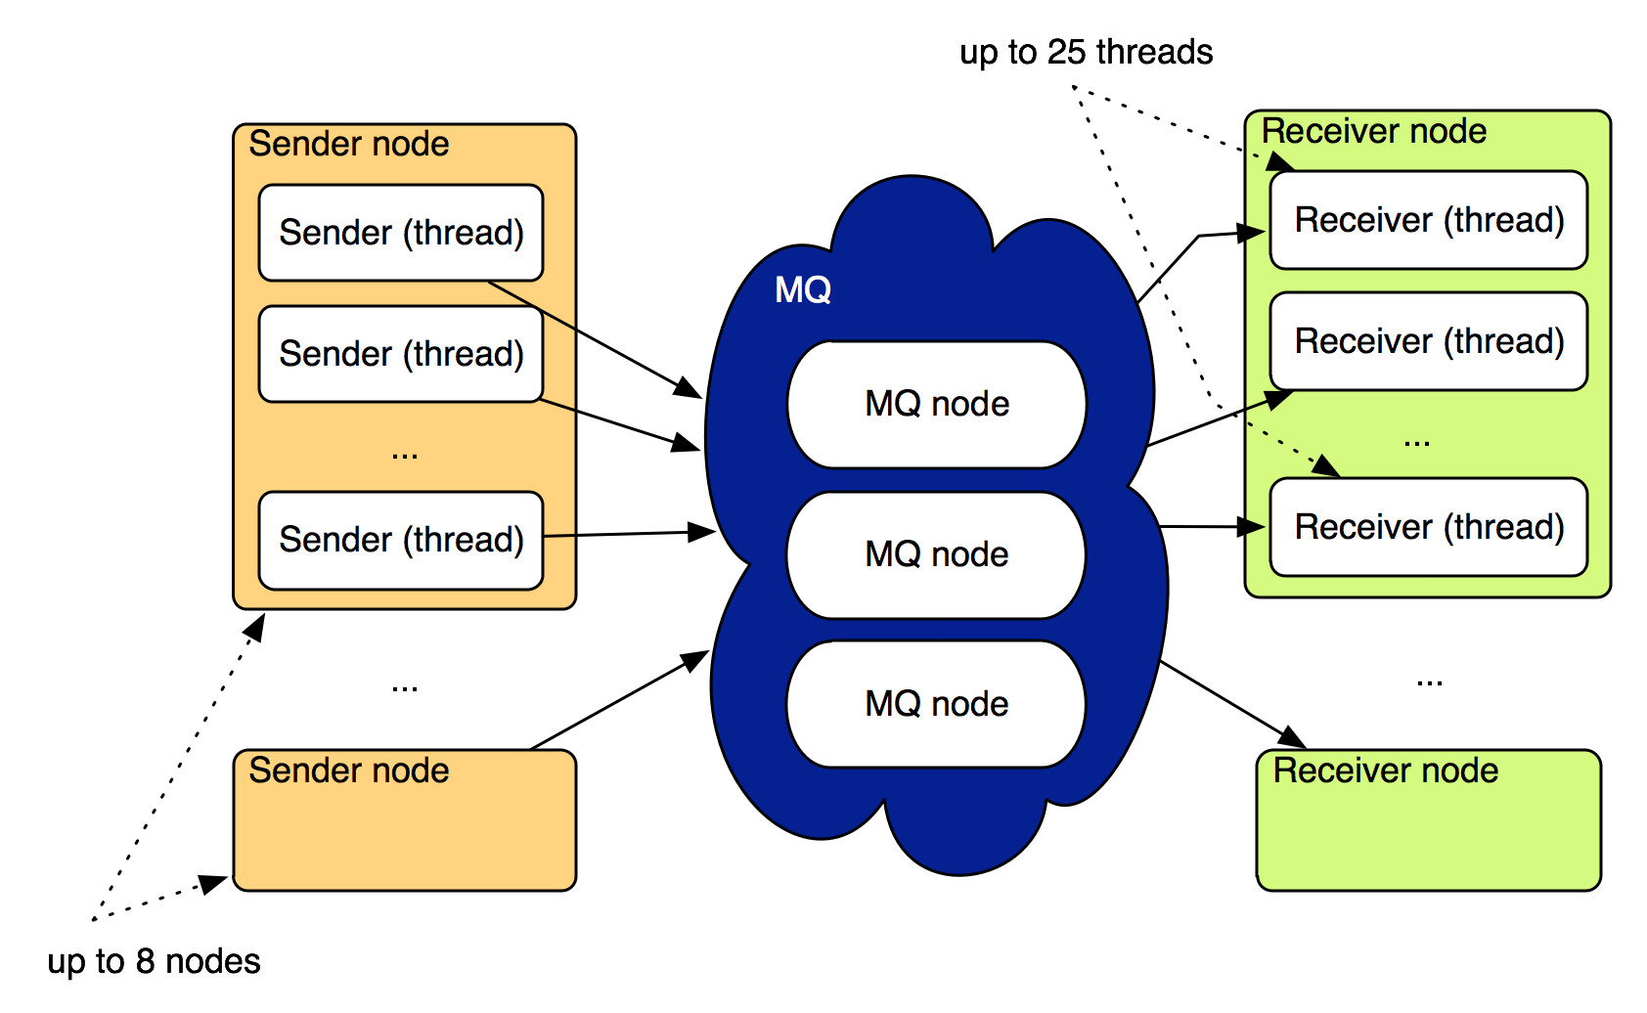
Performance

Slide 26
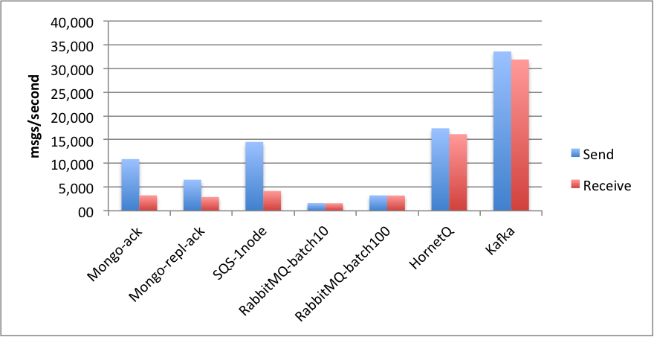
Performance

Slide 27
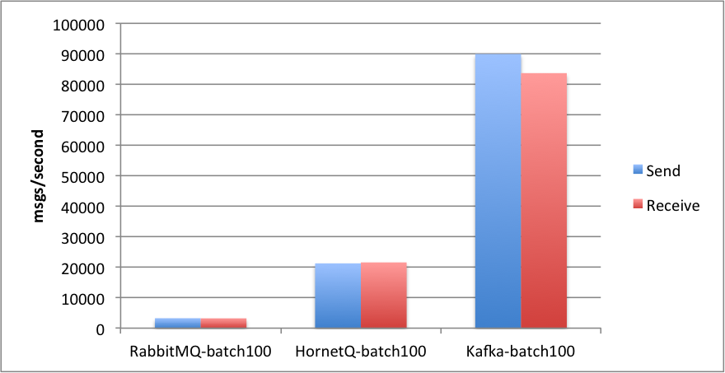
Performance

Slide 28
Thank you

